Slide 1

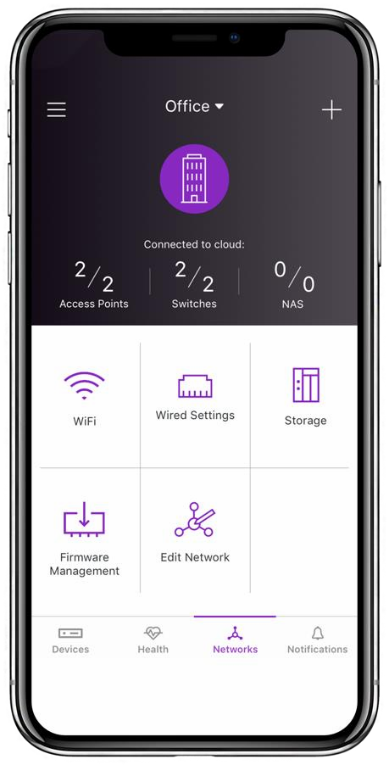



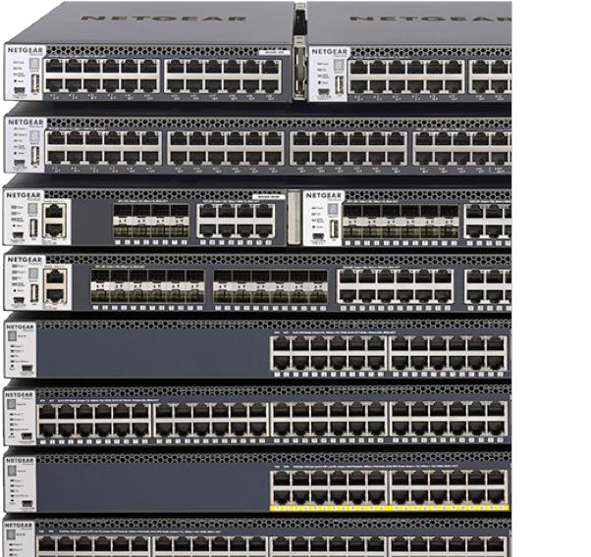
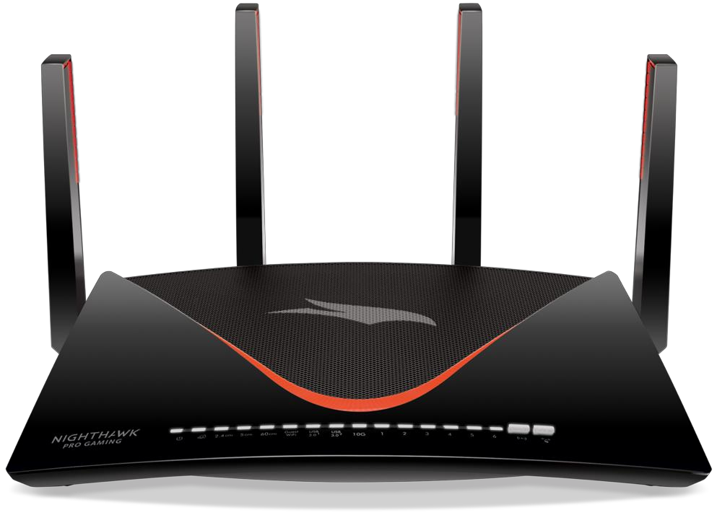
Cost of Complexity Project for New Products in CHP

Slide 2

Agenda
Team Introduction
Executive Summary
SKUs selected for analysis
Pareto 80/20 analysis
Obvious cut-offs for profits
Trends
Demo
Perceptual Maps/Competitive Analysis
Summary
Q&A

Slide 3







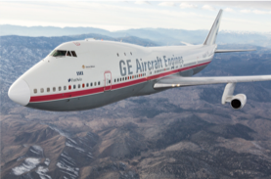


Masters in Aerospace/
Bachelors in Aerospace
GE Aviation |5+ years | Senior Application Engineer | Agile Scrum Master
Trekking
Minsuk
Gregy Thomas
MS in Business Analytics

Slide 4





B.S. in Business Administration Finance at UNC Pembroke
China Resources - Fortune Global 500;
Created KPI dashboards to track weekly performance of QDII cooperation projects between CR Trust and Morgan Stanley,
Travelling
Volunteering in Aiesec Cambodia
Minsuk
Mingyu Liao
MS in Business Analytics
Notes:
A passionate “data story teller”! I use data and technology to empower people and provide innovative solutions to employers

Slide 5







Masters in Mathematics/
Bachelors in Electrical Engineering
Product Manager for e-commerce websites
Software developer : Developing network monitoring devices
Travelling and Dancing
Minsuk
Manasa Nelakuditi
MBA

Slide 6




Masters in Financial Management/
Bachelors in International Economics and Trade
Annie has 3+ years of experience in financial management and has worked with top-tier venture capital firm to connect the best technology startups with the world’s largest corporations for cross-border businesses.
Photography
Guzheng
Annie Song
MBA
Notes:
I moved more than 10 times and 5 cities over the past 10 years.

Slide 7
Executive Summary
Built a model to list out the bottom 20% of profits (after careful allocation of marketing and warranty costs) on Netgear’s Router, Range extender, Cable and WIFI-System product lines
Analysed the variation of product quantity with the price change
Evaluated the competitive analysis and produced the perceptual map

Slide 8
SKUs selected for Analysis
Years 2017(Q1-Q4) - 2018(Q1-Q3)
Excluded products only sold in 2018 and not in 2017
Excluded all EOLs based on the data provided to us
Products: Cable, Range extender, Routers and WIFI-Systems
Intra cross elasticity includes the item skus belongs to that product line only
Standard Cost, not Extended Standard Cost
Excluded products that have small negative quantities and/or revenues

Slide 9
Pareto
Sales Margin
Standard Cost
Sales Thru Qty
Sales Thru Dollars

Slide 10
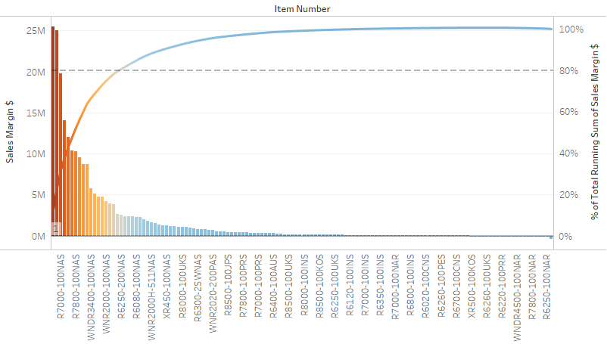
Routers Sales Margin

Slide 11
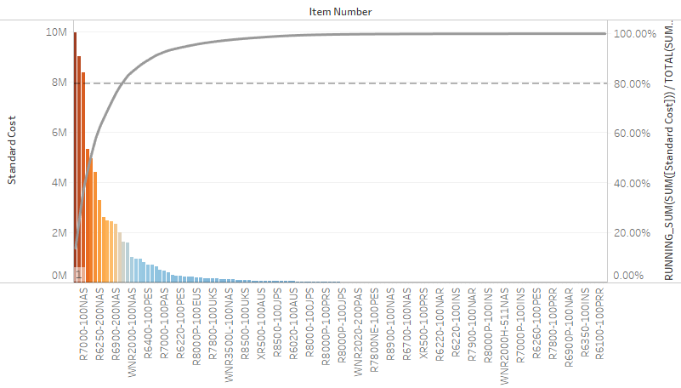
Routers Standard Cost

Slide 12
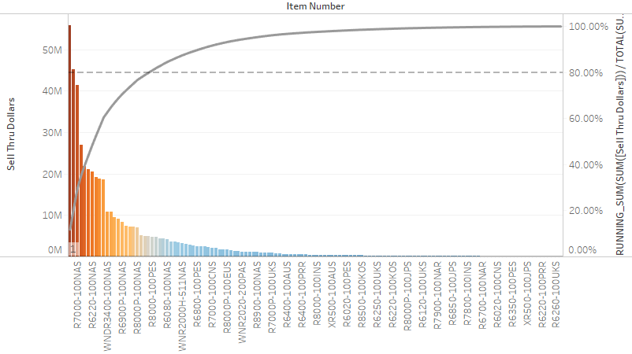
Routers Sell Thru Dollars

Slide 13
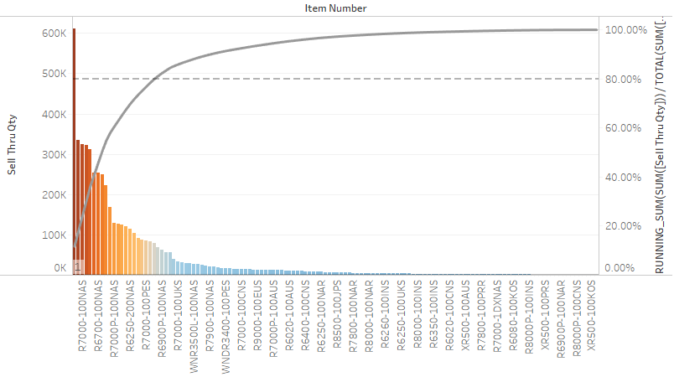
Routers Sell Thru Qty

Slide 14
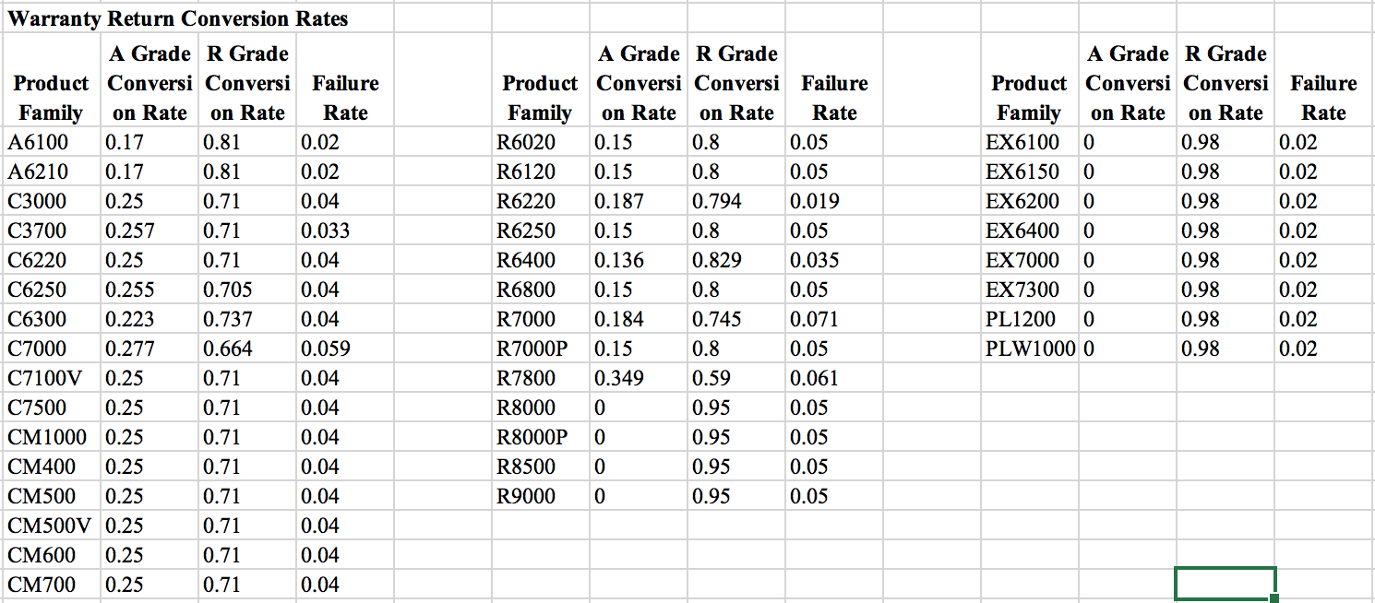
Return Conversion Rates & Marketing Cost

Slide 15
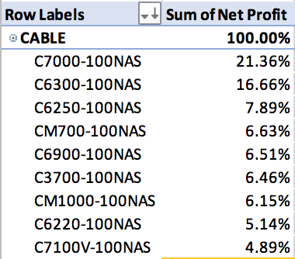
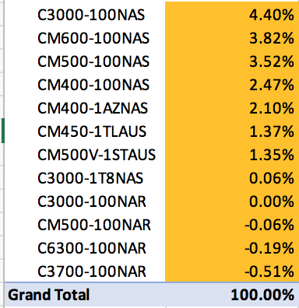
Cable

Slide 16
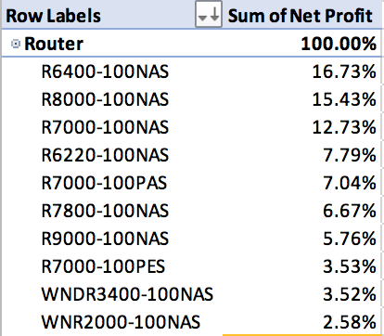
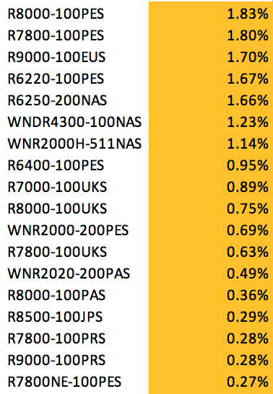
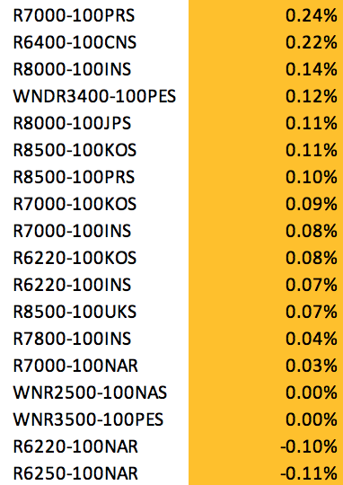
Router

Slide 17
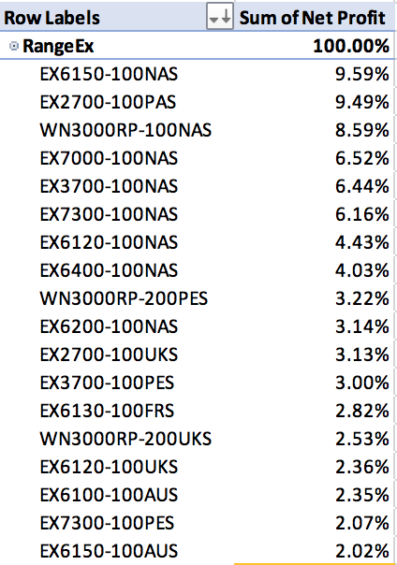
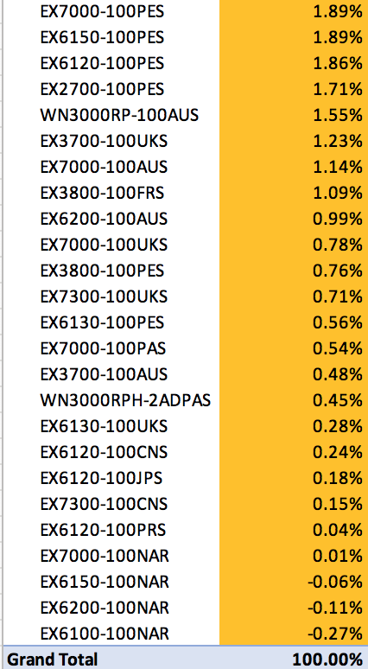
Range Extender

Slide 18
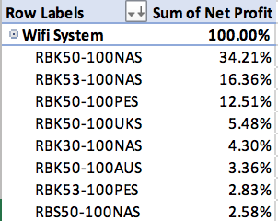
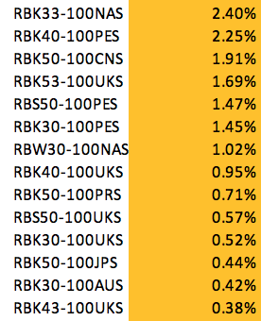
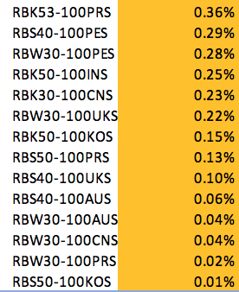
Wifi System

Slide 19
Trend Analysis
Revenue
Revenue Ranking
Net Profit
Net Profit Percentile

Slide 20
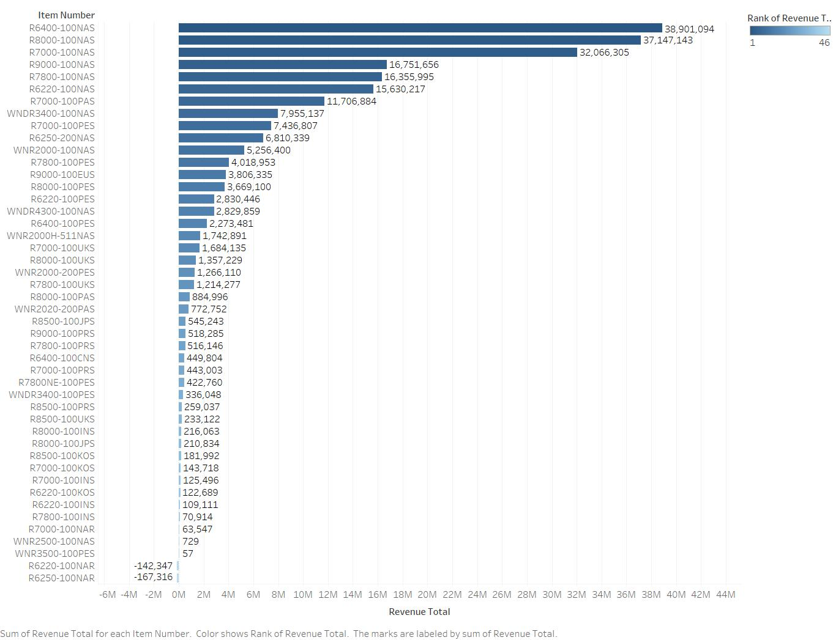
Router Item-wise Revenue Distribution

Slide 21
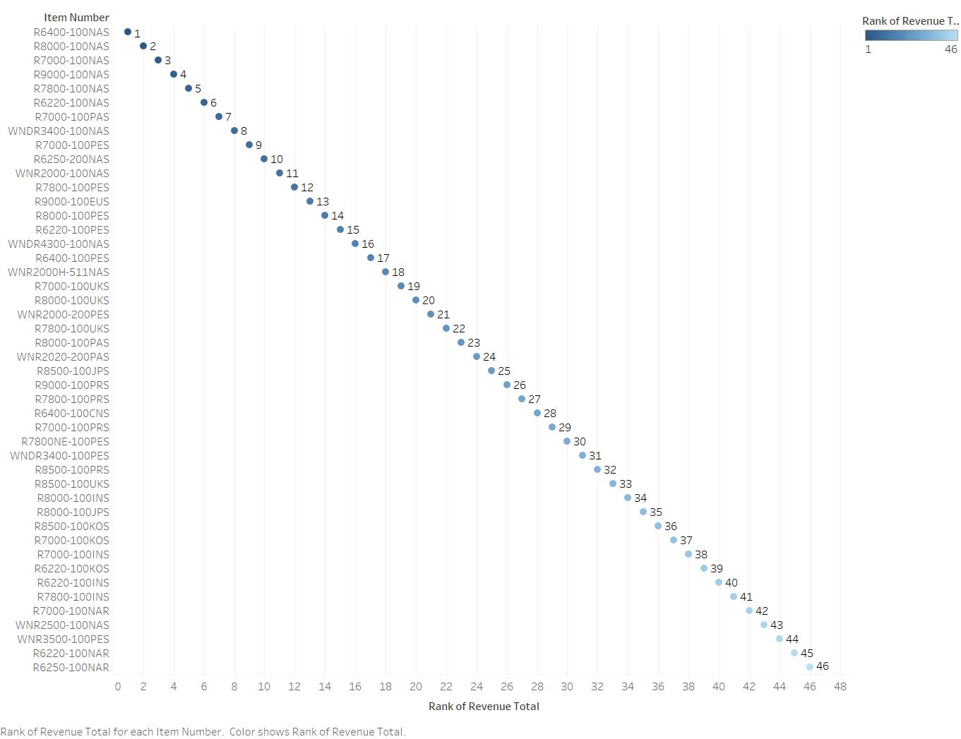
Router Item-wise Revenue Rank

Slide 22
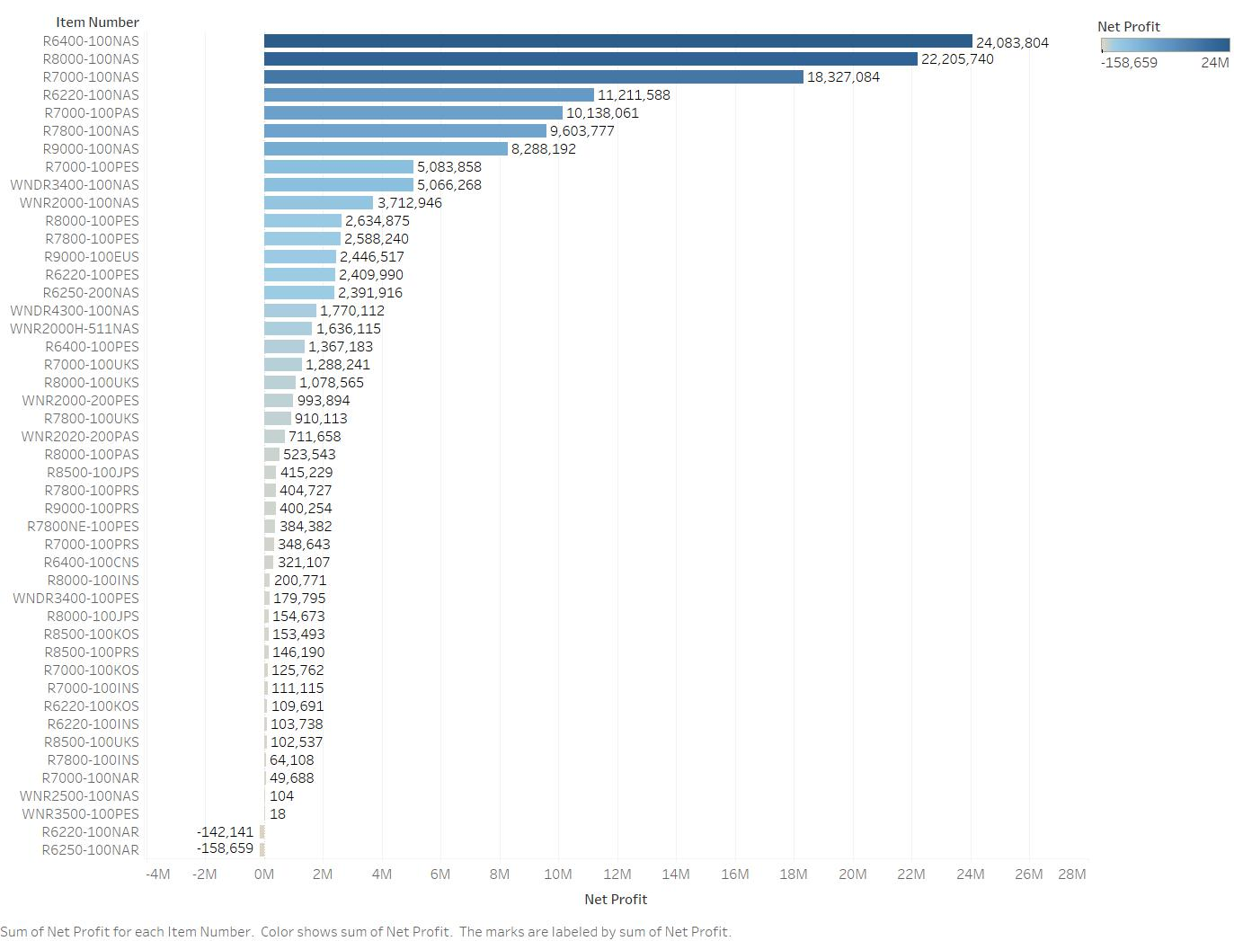
Router Item-wise Net Profit Distribution

Slide 23
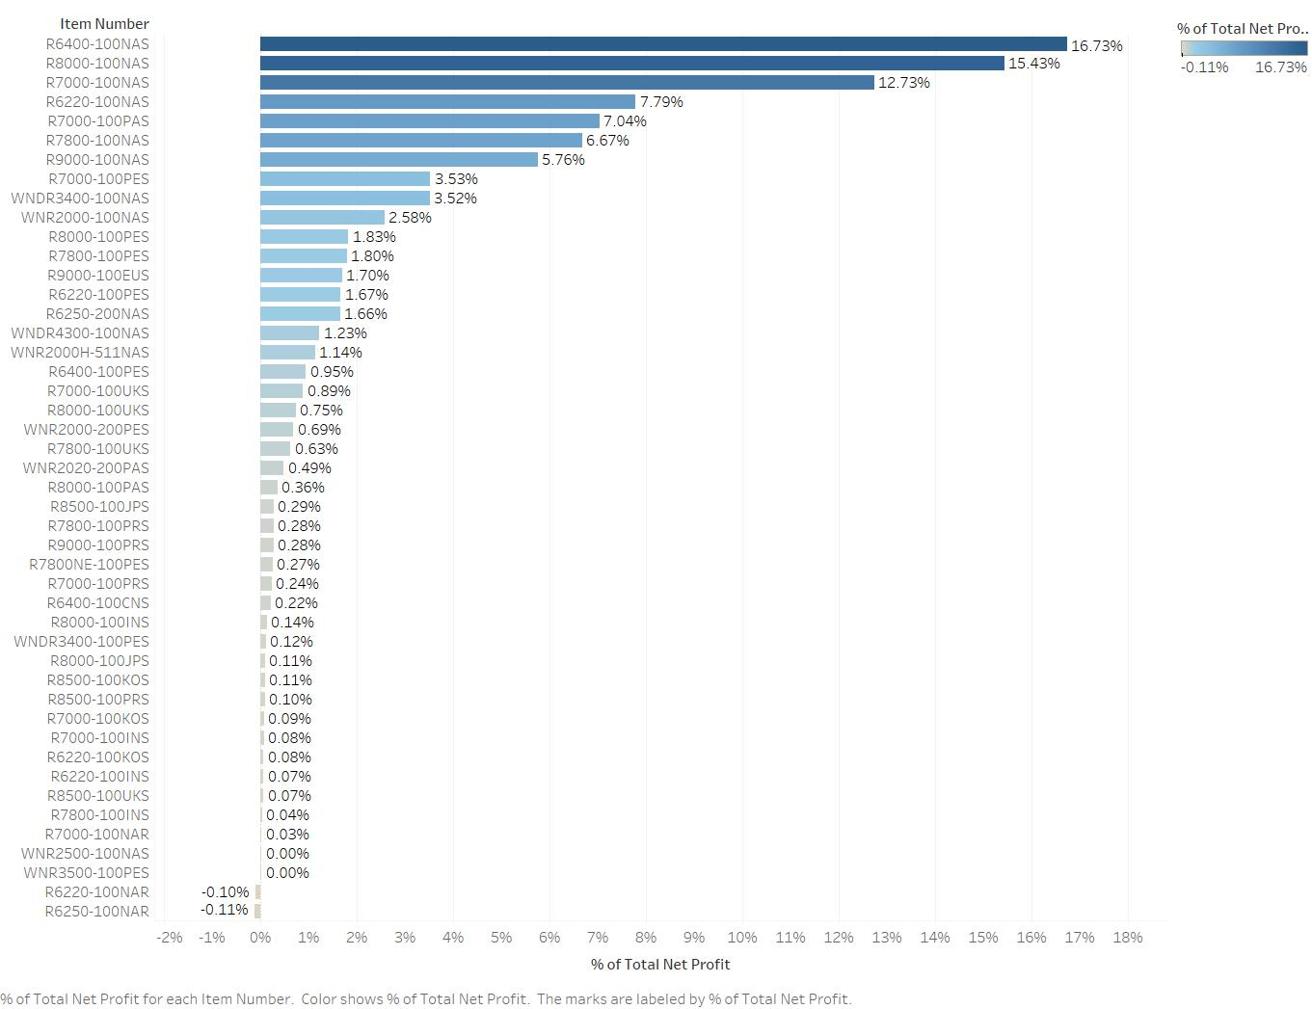
Router Item-wise Net Profit Percentile Distribution

Slide 24
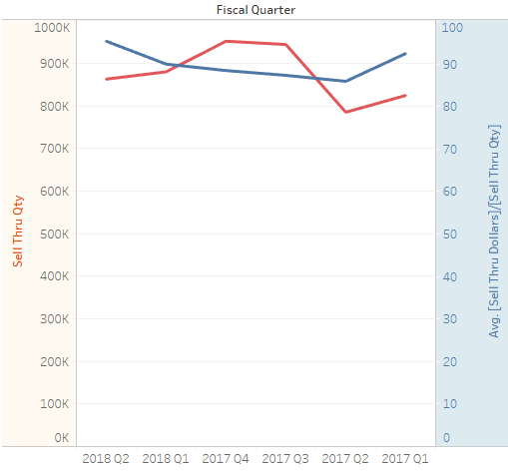
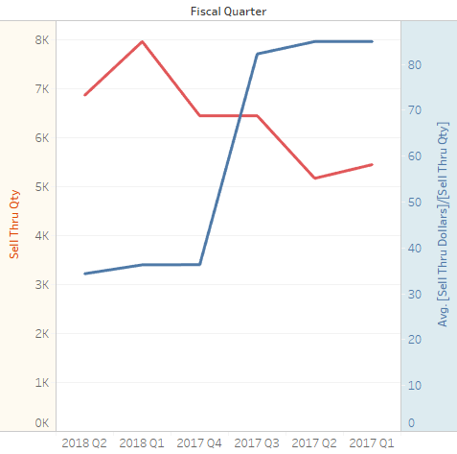
Price Vs Quantity – Routers
Router : All Items
Router Item: R6020-100AUS

Slide 25
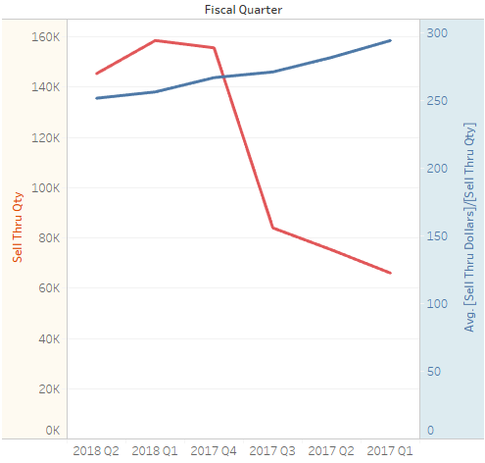
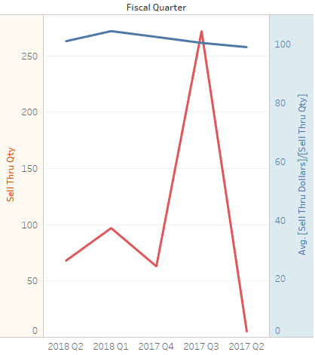
Price Vs Quantity – WiFi
WiFi: All Items
WiFi Item: RBW300-100AUS

Slide 26
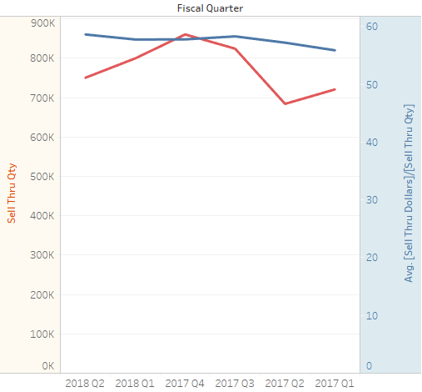
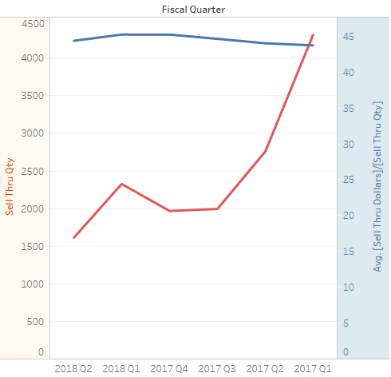
Price Vs Quantity – Range Extender
Range Ex: All Items
Range Ex Item: EX3700-100AUS

Slide 27
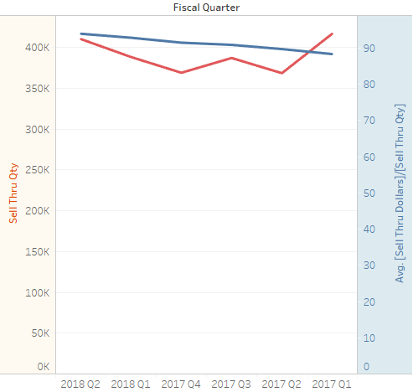
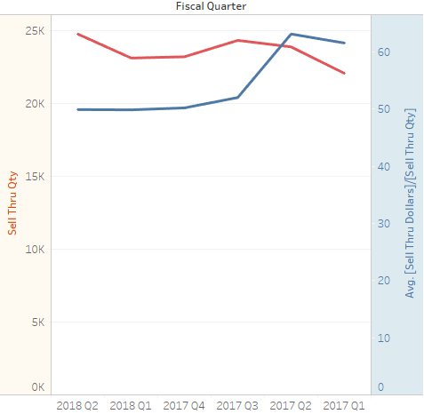
Price Vs Quantity – Cable
Cable : All Items
Cable Item: CM500-100NAS

Slide 28
Q & A

